Slide 1

Computer Engineering Department A.P. Shah Institute of Technology G.B.Road, Kasarvadavli, Thane(W), Mumbai-400615 UNIVERSITY OF MUMBAI Academic Year 2021-2022

Slide 2
Synopsis on Malicious URL Detection Submitted in partial fulfillment of the degree of Bachelor of Engineering(Sem-5) in Computer Engineering By Shauryan Singh(19102004) Aditya Yadav(19102006) Viraj Jadhav(19102022)
Parag Patil(19102039)
Under the Guidance of Sofiya Mujawar

Slide 3
1.Project Conception and Initiation

Slide 4
1.1 Abstract
A malicious website, is a common and serious threat to cybersecurity. Malicious URLs host unsolicited content (spam, phishing, etc.) and lure unsuspecting users to become victims of scams(monetary loss, theft of private information, and malware installation).
Recently, with the increase in Internet usage, cybersecurity has been a significant challenge for computer systems.
Our project proposes using host-based and lexical features of the associated URLs to better improve the performance of classifiers for detecting malicious web sites.
The results show that being able to identify malicious websites based on URL alone and classify them as spam URLs without relying on page content will result in significant resource savings as well as safe browsing experience for the user.

Slide 5
1.2 Objectives
To Detect and Notify the user about the url being malicious or benign.
To protect user’s sensitive data in case of phishing url attack.
Our ultimate goal is to contribute to the creation of a real time malware classifier to block out malicious URLs.

Slide 6
1.3 Literature Review
Paper Name | Year | Author Name | Features
Malicious URL Detection based on Machine Learning | 2020 | Cho Do Xuan, Hoa Dinh Nguyen, Tisenko Victor Nikolaevich | Method for malicious URL detection using machine learning is presented URL Attribute Extraction and Selection
Malicious URL Detection using Machine Learning: A Survey | 2019 | DOYEN SAHOO, CHENGHAO LIU, STEVEN C.H. HOI | Host-based Features Lexical Features Content-based Features Popularity Features

Slide 7
1.3 Literature Review
Blacklisting or Heuristic Approaches
Blacklisting approaches are a common and classical technique for detecting malicious URLs, which often maintain a list of URLs that are known to be malicious. Whenever a new URL is visited, a database lookup is performed. If the URL is present in the blacklist, it is considered to be malicious and then a warning will be generated; else it is assumed to be benign.
Machine Learning Approaches
These approaches try to analyze the information of a URL and its corresponding websites or webpages, by extracting good feature representations of URLs, and training a prediction model on training data of both malicious and benign URLs.
Lexical Features
Lexical features are features obtained from the properties of the URL name (or the URL string). The motivation is that based on how the URL "looks" it should be possible to identify the malicious nature of a URL. For example, many obfuscation methods try to "look" like benign URLs by mimicking their names and adding a minor variation to it.
Host-based Features
Host-based features are obtained from the host-name properties of the URL. They allow us to know the location, identity, and the management style and properties of malicious hosts.
Popularity Features
Some other features used were designed as heuristics to measure the popularity of the URL. One of the earliest approaches to applying statistical techniques to detect malicious URLs aimed at probabilistically identifying the importance of specific hand-designed features. These include Page-based features (Page rank, quality, etc.)

Slide 8
1.4 Problem Definition
Developing a machine learning model capable of detecting malicious URL’s which will protect the privacy and integrity of sensitive credentials of the users and warning the users about its danger in the form of an interface or a service.

Slide 9
1.5 Scope
In this model, we further aim to improve our classifiers accuracy so that our model can more accurately classify URLs and eliminate even a minute chance of any breach.
The functionality of adding this model as a chrome extension will make it a lot more responsive and increase its usability.

Slide 10
1.6 Technology stack
Python: Python is a computer programming language often used to build websites and software, automate tasks, and conduct data analysis. Python is a general purpose language, meaning it can be used to create a variety of different programs and isn’t specialized for any specific problems. This versatility, along with its beginner-friendliness, has made it one of the most-used programming languages today.
Sklearn: Scikit-learn (Sklearn) is the most useful and robust library for machine learning in Python. It provides a selection of efficient tools for machine learning and statistical modeling including classification, regression, clustering and dimensionality reduction via a consistent interface in Python.
Pandas: Pandas is an open-source, licensed Python library providing high-performance, easy-to-use data structures and data analysis tools for the Python programming language.

Slide 11
1.7 Benefits for environment & Society
Malicious URL detection using machine learning can have immense real-world applications. However, it is nontrivial to make it work in practice. Several researchers have proposed architectures for building end-to-end malicious URL Detection systems and deployed them for real-world utilities.
Malicious URL detector has many real time applications . One of the main advantage of using these url detectors is to protect your system from phishing and various cyber attacks.This detection using machine learning is more useful for the people from non technical background who find it hard to differentiate between those scam and legitimate websites.

Slide 12
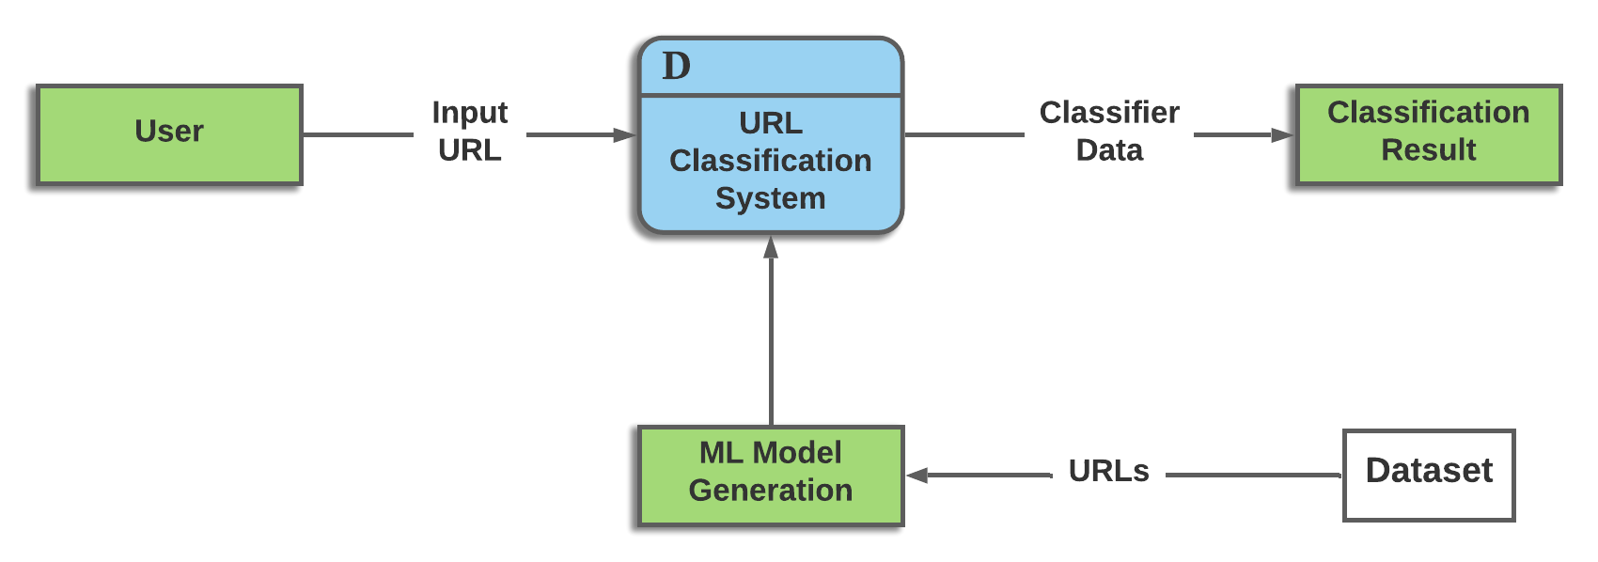
1.8 Data Flow Diagram

Slide 13
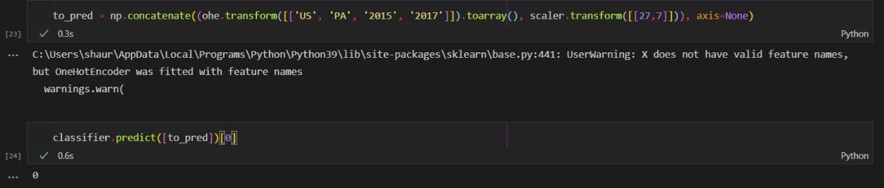
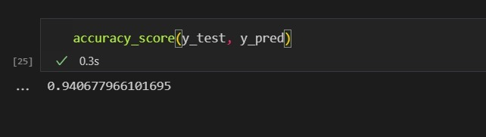
1.9 Output Snippets

Slide 14
Thank You

